Slide 1
EE 538 - Computing Principles for Electrical Engineers
Spring 2022
TROJAN MAP
Presented By:
Krishna Dheeraj Krovi
Nikhil Manjunath

Slide 2
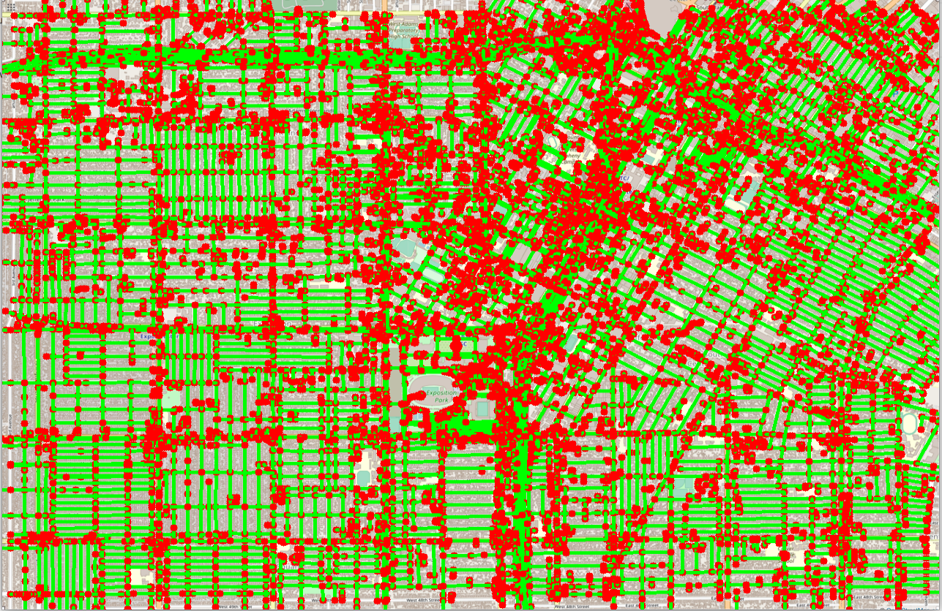
TROJAN MAP
A Map of locations around USC using C++ Data Structures and Graph Algorithms.
The Red Dots ( ) represent various locations in and around USC.
The Green Lines ( ) represent the various pathways.

Slide 3
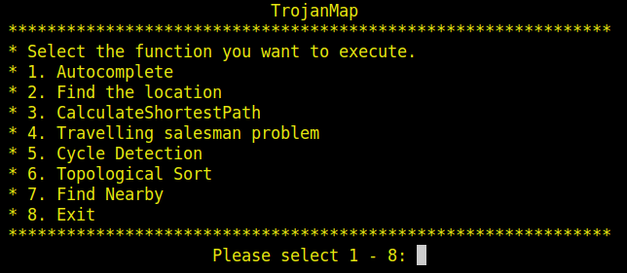
OBJECTIVES
Implemented the following functions:
Autocomplete
Find location
CalculateShortestPath
Travelling salesman problem
Cycle Detection
Topological Sort
Find K Closest Points

Slide 4
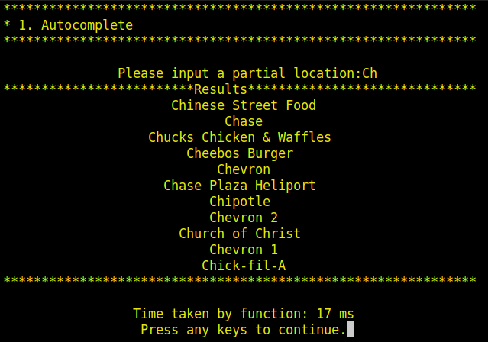
AUTOCOMPLETE
Added features such as dealing with Case Insensitive input, invalid inputs.
Compares the input string with every node in the map and returns those nodes whose names start with the same letters.
Time Complexity is O(N)
Input String
Autocomplete Output

Slide 5
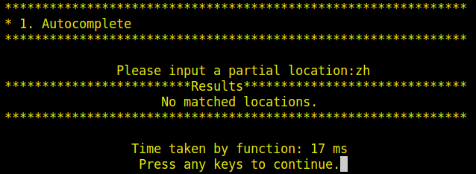
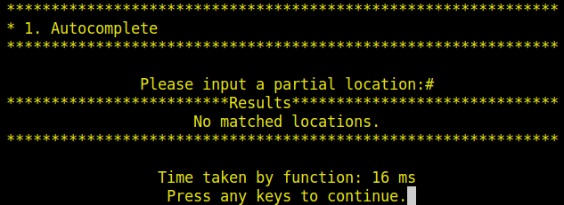
AUTOCOMPLETE
Another valid test case
Output for Input location: zh
Invalid test case
Output for invalid Input location: #

Slide 6
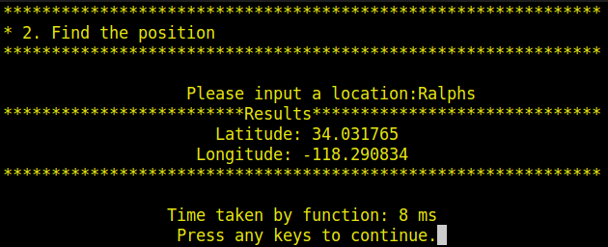
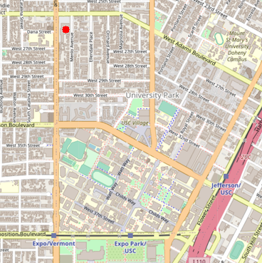
FIND LOCATION COORDINATES
INPUT LOCATION
Compares User Input to all the nodes in the map and returns the Latitude and Longitude of the matched location.
Also marks the location on the Trojan Map
Added a feature “Closest name” to correctly show mispelt places.
Time Complexity: O(N)
Target
OUTPUT COORDINATES
MARKED LOCATION
ON MAP

Slide 7
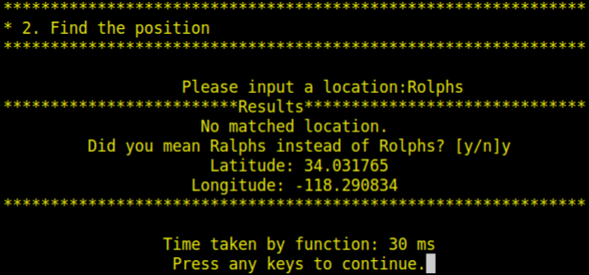
FIND LOCATION COORDINATES
FIND CLOSEST NAME
Algorithm Used: Edit Distance
Steps:
Compares incorrectly spelt string with every node.
Calculates distance of the string from the nodes using Dynamic Programming
(Distance = Number of Insert/Remove/Replace characters needed to convert the input string to the node name)
Return the Node with the smallest distance from the Input String
AUTOCOMPLETE OUTPUT
INCORRECTLY SPELT INPUT

Slide 8
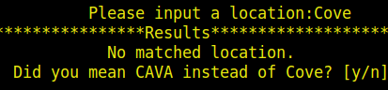
FIND LOCATION COORDINATES
Edit Distance
For Input Cove, we get CAVA as the corrected word.
 | C | O | V | E
C | 0 | 1 | 2 | 3
A | 1 | 1 | 2 | 3
V | 2 | 2 | 1 | 2
A | 3 | 3 | 2 | 2
Output of Find Location
EditDistance(“CAVA”,”COVE”) = 2

Slide 9
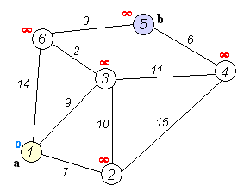
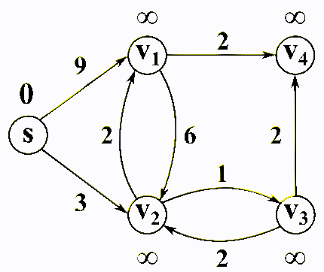
SHORTEST PATH
DJIKSTRA
BELLMAN-FORD
Greedy Algorithm
Cannot handle Negative Edges
Faster Execution Time
Time Complexity: O(E*log(V))
Can handle Negative Edges
Slower Execution time O(V^3) but can be made faster by Early stopping.
Time Complexity: O(E*V)
Source: https://upload.wikimedia.org/wikipedia/commons/5/57/Dijkstra_Animation.gif,
https://commons.wikimedia.org/wiki/File:Bellman%E2%80%93Ford_algorithm_example.gif

Slide 10
SHORTEST PATH
Comparison of Execution times for Djikstra and Bellman Ford
SOURCE | DESTINATION | DJIKSTRA | BELLMAN-FORD
Ralphs | Target | 70ms | 5864ms
Starbucks 2 | Chipotle | 63ms | 5974ms
Chinese Street Food | KFC | 48ms | 5311ms

Slide 11
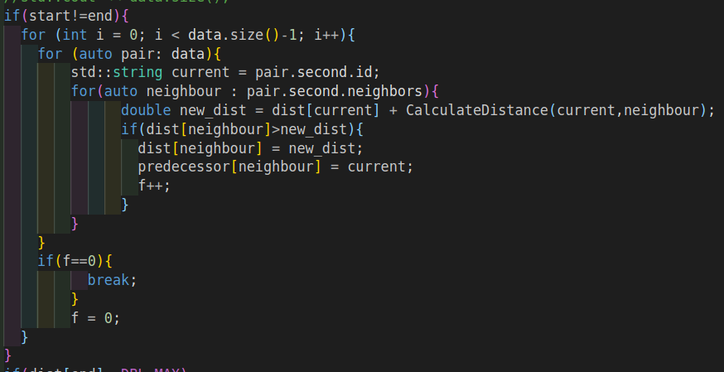
Bellman Ford Algorithm - Early Stopping
Stop when there are no changes

Slide 12
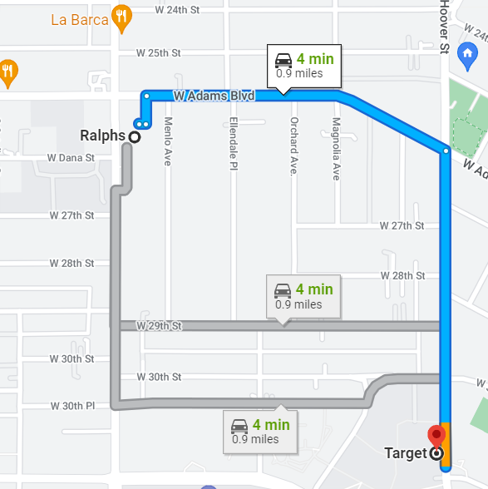
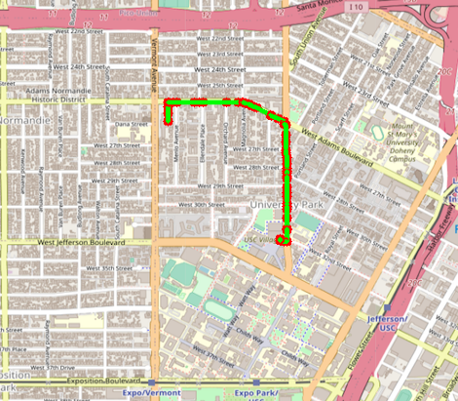

SHORTEST DISTANCE
Comparing output with Google Maps.
Source: Ralphs
Destination: Target
Google Maps
Trojan Maps
Almost..
Google Maps Output: 0.9miles

Slide 13
TRAVELLING TROJAN
Similar to the famous Travelling Sales Person problem.
WORKING:
Input Number of Locations (N)
Randomly pick N locations on Map
Run Algorithms to find Shortest Path
Return Path Animation
ALGORITHMS:
BRUTE-FORCE | BACKTRACKING | 2-OPT
Consider all combinations of locations. Return the combination with smallest distance. | Terminate recursive distance calculations when the distance exceeds the shortest distance. | Local Optimum Finding algorithm that keeps finding new paths until a better path is not available.
Time Complexity: O(N!) | Time Complexity: O(N!) | Time Complexity: O(N^2)

Slide 14
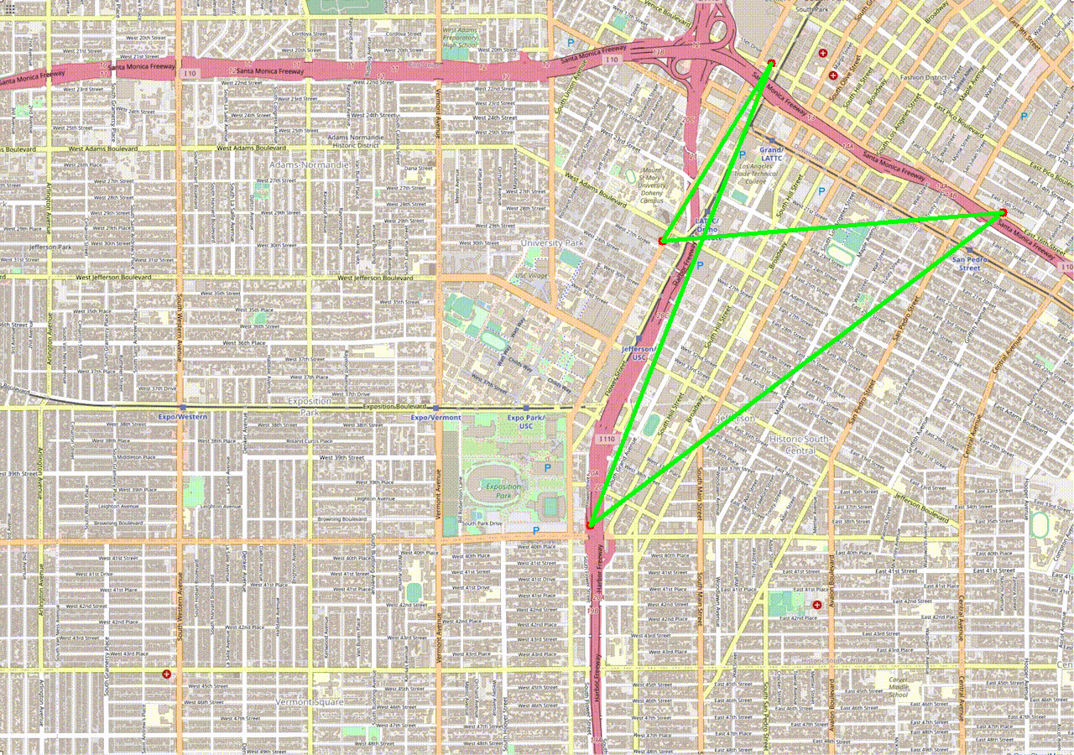

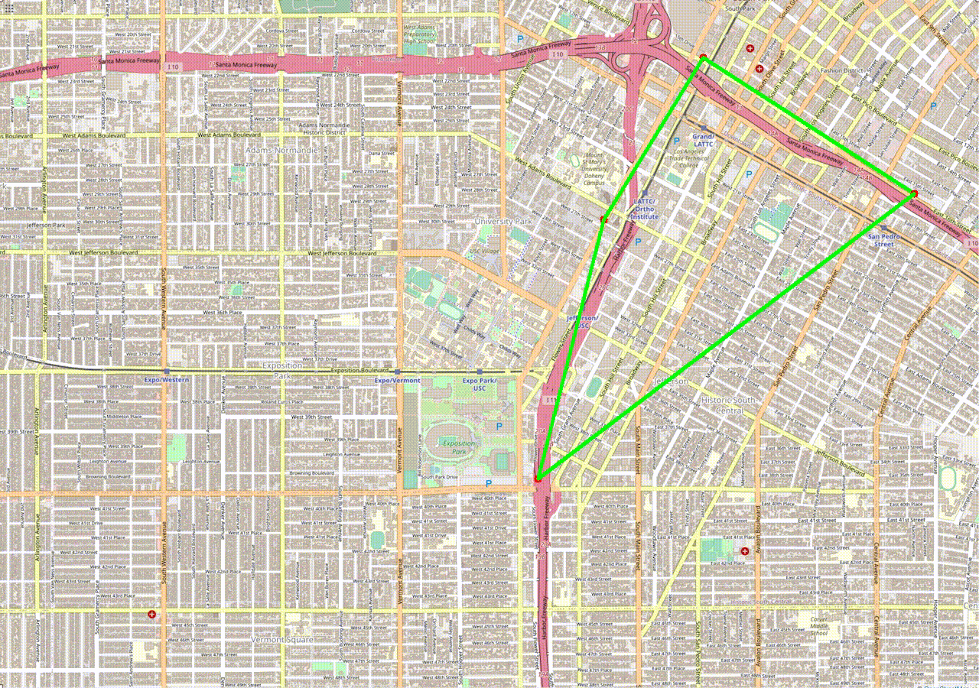
TRAVELLING TROJAN
TRAVELLING TROJAN OUTPUTS FOR N=4:
BRUTE-FORCE
BACKTRACKING
2-OPT

Slide 15
TRAVELLING TROJAN
Execution time in milliseconds
Algorithm used
` | Brute Force | Back Tracking | 2-Opt
N=5 | 0 | 0 | 0
N=7 | 20 | 6 | 0
N=9 | 450 | Timeout | 5
N=15 | Timeout | Timeout | 12
No.of random locations
Shortest path distance in miles
2-Opt has the lowest Computation time!
Algorithm used
` | Brute Force | Back Tracking | 2-Opt
N=5 | 6.134 | 6.134 | 6.134
N=7 | 4.916 | 4.916 | 4.916
N=9 | 8.571 | Timeout | 9.048
N=15 | Timeout | Timeout | 11.74
No.of random locations

Slide 16
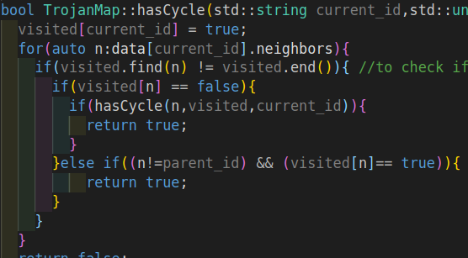
CYCLE DETECTION
Algorithm Used: DFS + DP
Steps:
Create a subgraph from the coordinates given.
Traverse through all the nodes inside the subgraph, while keeping a track of the nodes visited.
If a visited node is revisited, then a cycle exits. The Cycle is plotted.
Time Complexity: O(N+E),
where N is the number of Nodes and E is the number of edges in the subgraph
DP
“An array a day keeps time complexity issues away.”

Slide 17
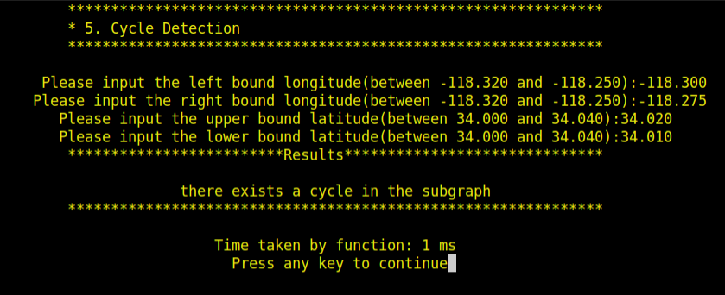
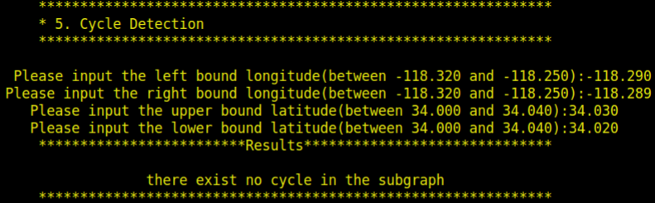
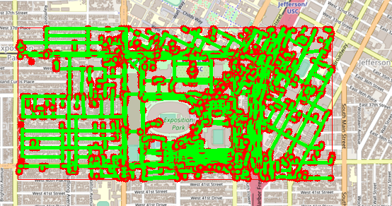
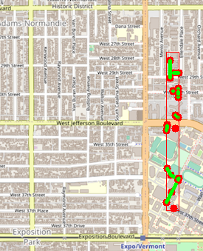
Results of the Cycle Detection function:
Cycle Found
No Cycle Found

Slide 18
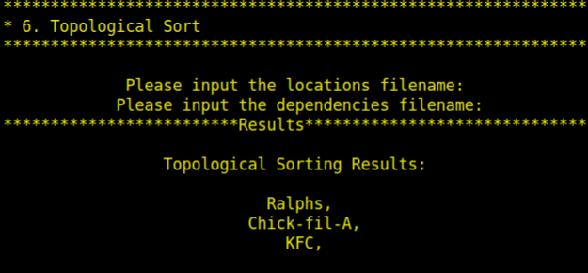
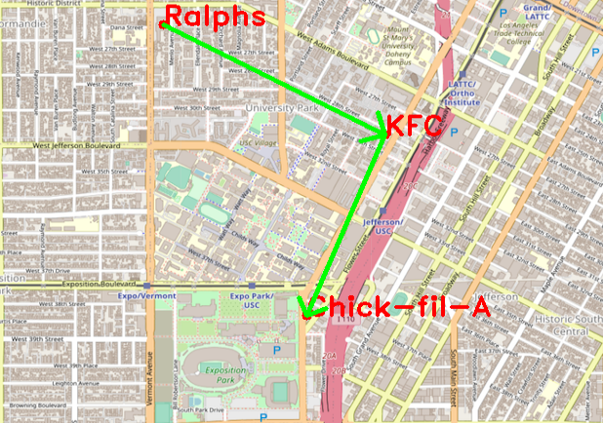
DELIVERING TROJAN
Algorithm Used DFS
Given Location and Dependencies, returns a feasible path for Tommy Trojan to follow if it exists.
Read Dependencies and Locations from CSV also implemented.
Time Complexity: O(N+E)

Slide 19
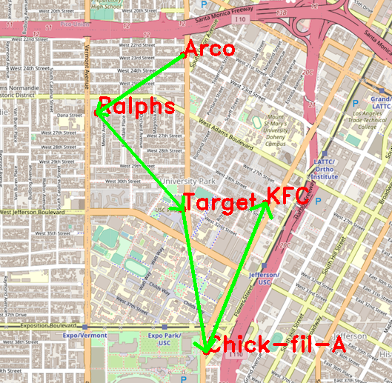
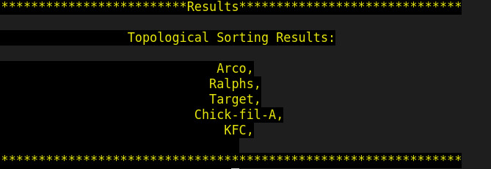
DELIVERING TROJAN
Input:
location_names = {"Ralphs", "Chick-fil-A", "KFC", "Target", "Arco"}
dependencies = {{"Ralphs","KFC"}, {"Ralphs","Chick-fil-A"}, {"Chick-fil-A", "KFC"}, {"Ralphs", "Target"}, {"Target", "KFC"}, {"Arco", "Ralphs"}}

Slide 20

FIND NEARBY
Takes as input: Location Name, Attribute, Search Radius(r) and Desired Number of Nearby Locations(k)
Max Heap (Priority Queue) to find K closest locations.
Display the closest locations on the Trojan Map
Time Complexity: O(N^2)

Slide 21
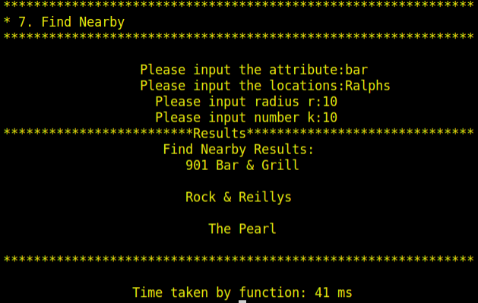
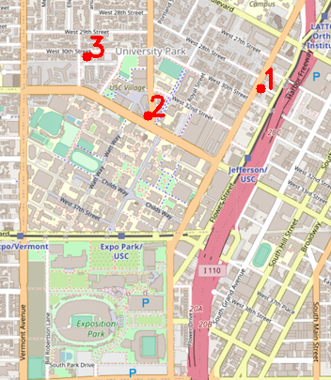
FIND NEARBY
Output for Nearby Bars:

Slide 22

CONCLUSION
We implemented this project with some of the most important data structures and algorithms and understood the advantages such as decrease in Runtime.
The project was exciting as we got to know the intuition behind how Google Maps, Apple Maps work.
We can extend this project to add bookmarks frequently travelled places for quick access.
Improving the speed of execution with better algorithms.
Extend support for different modes of transport like bike, automobile.

Slide 23
THANK YOU
FIGHT ON!

